Slide 1
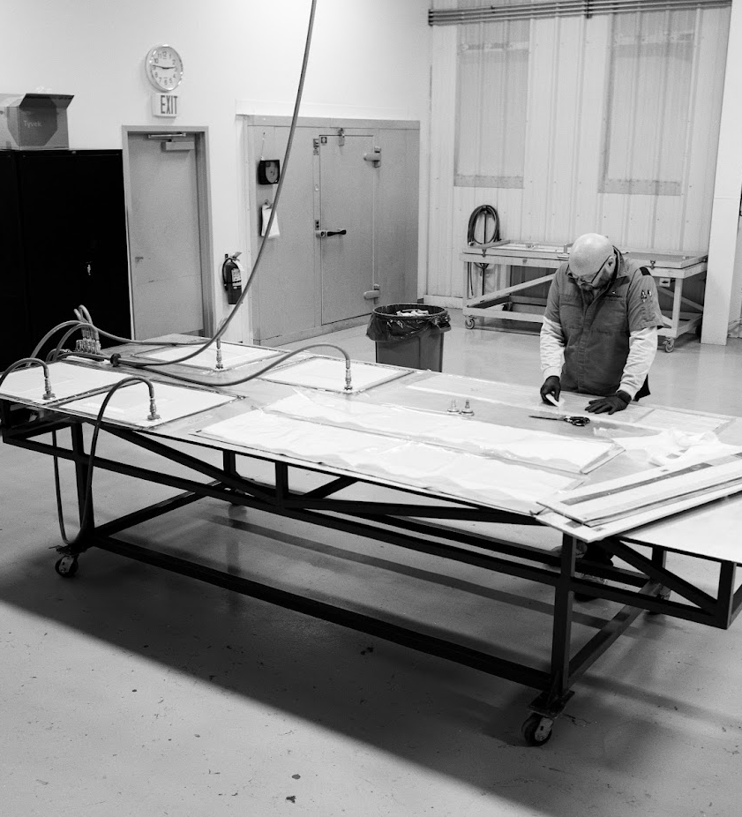
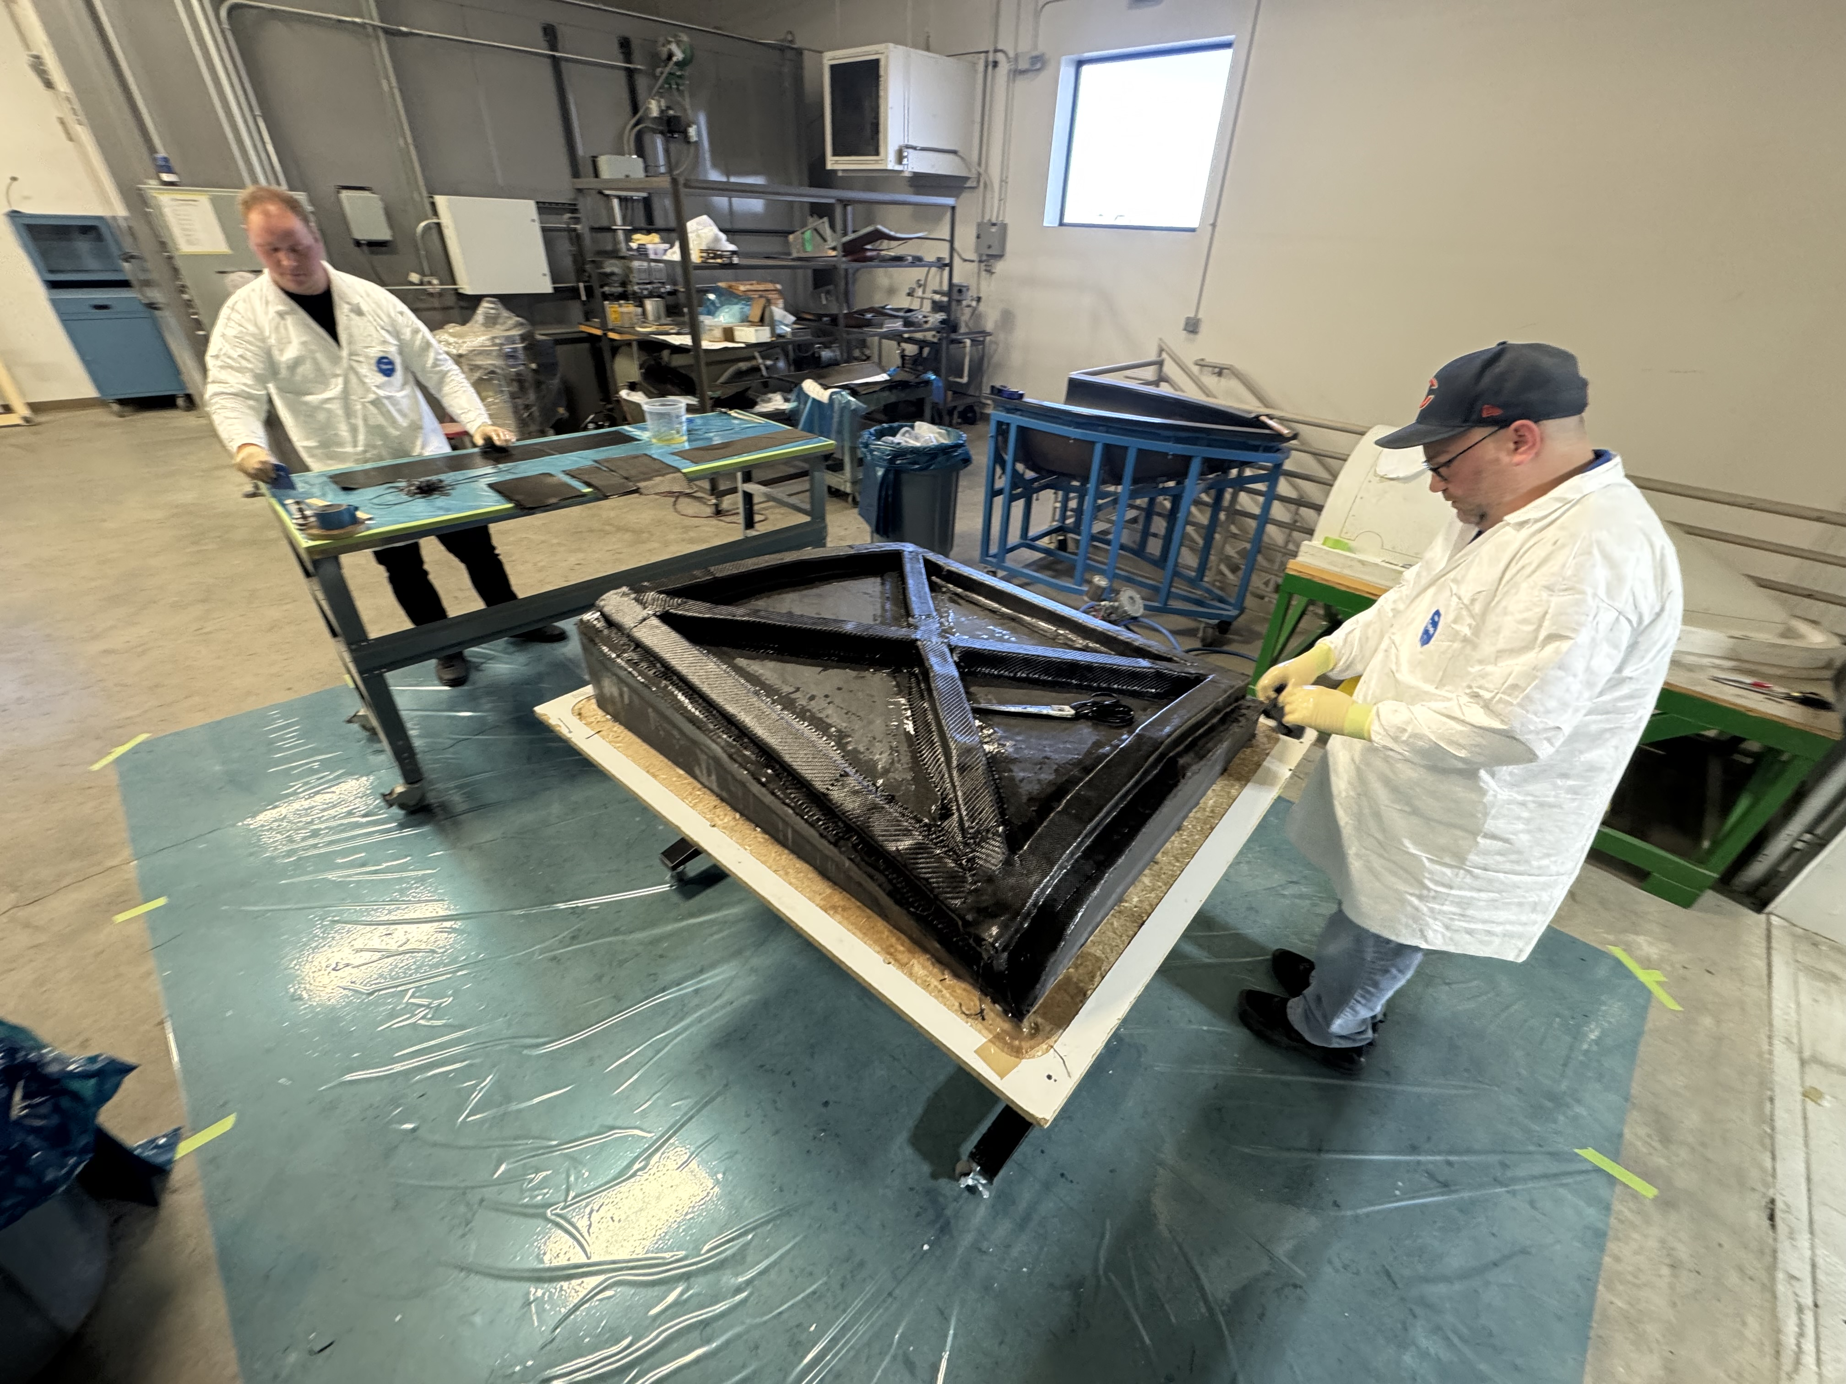

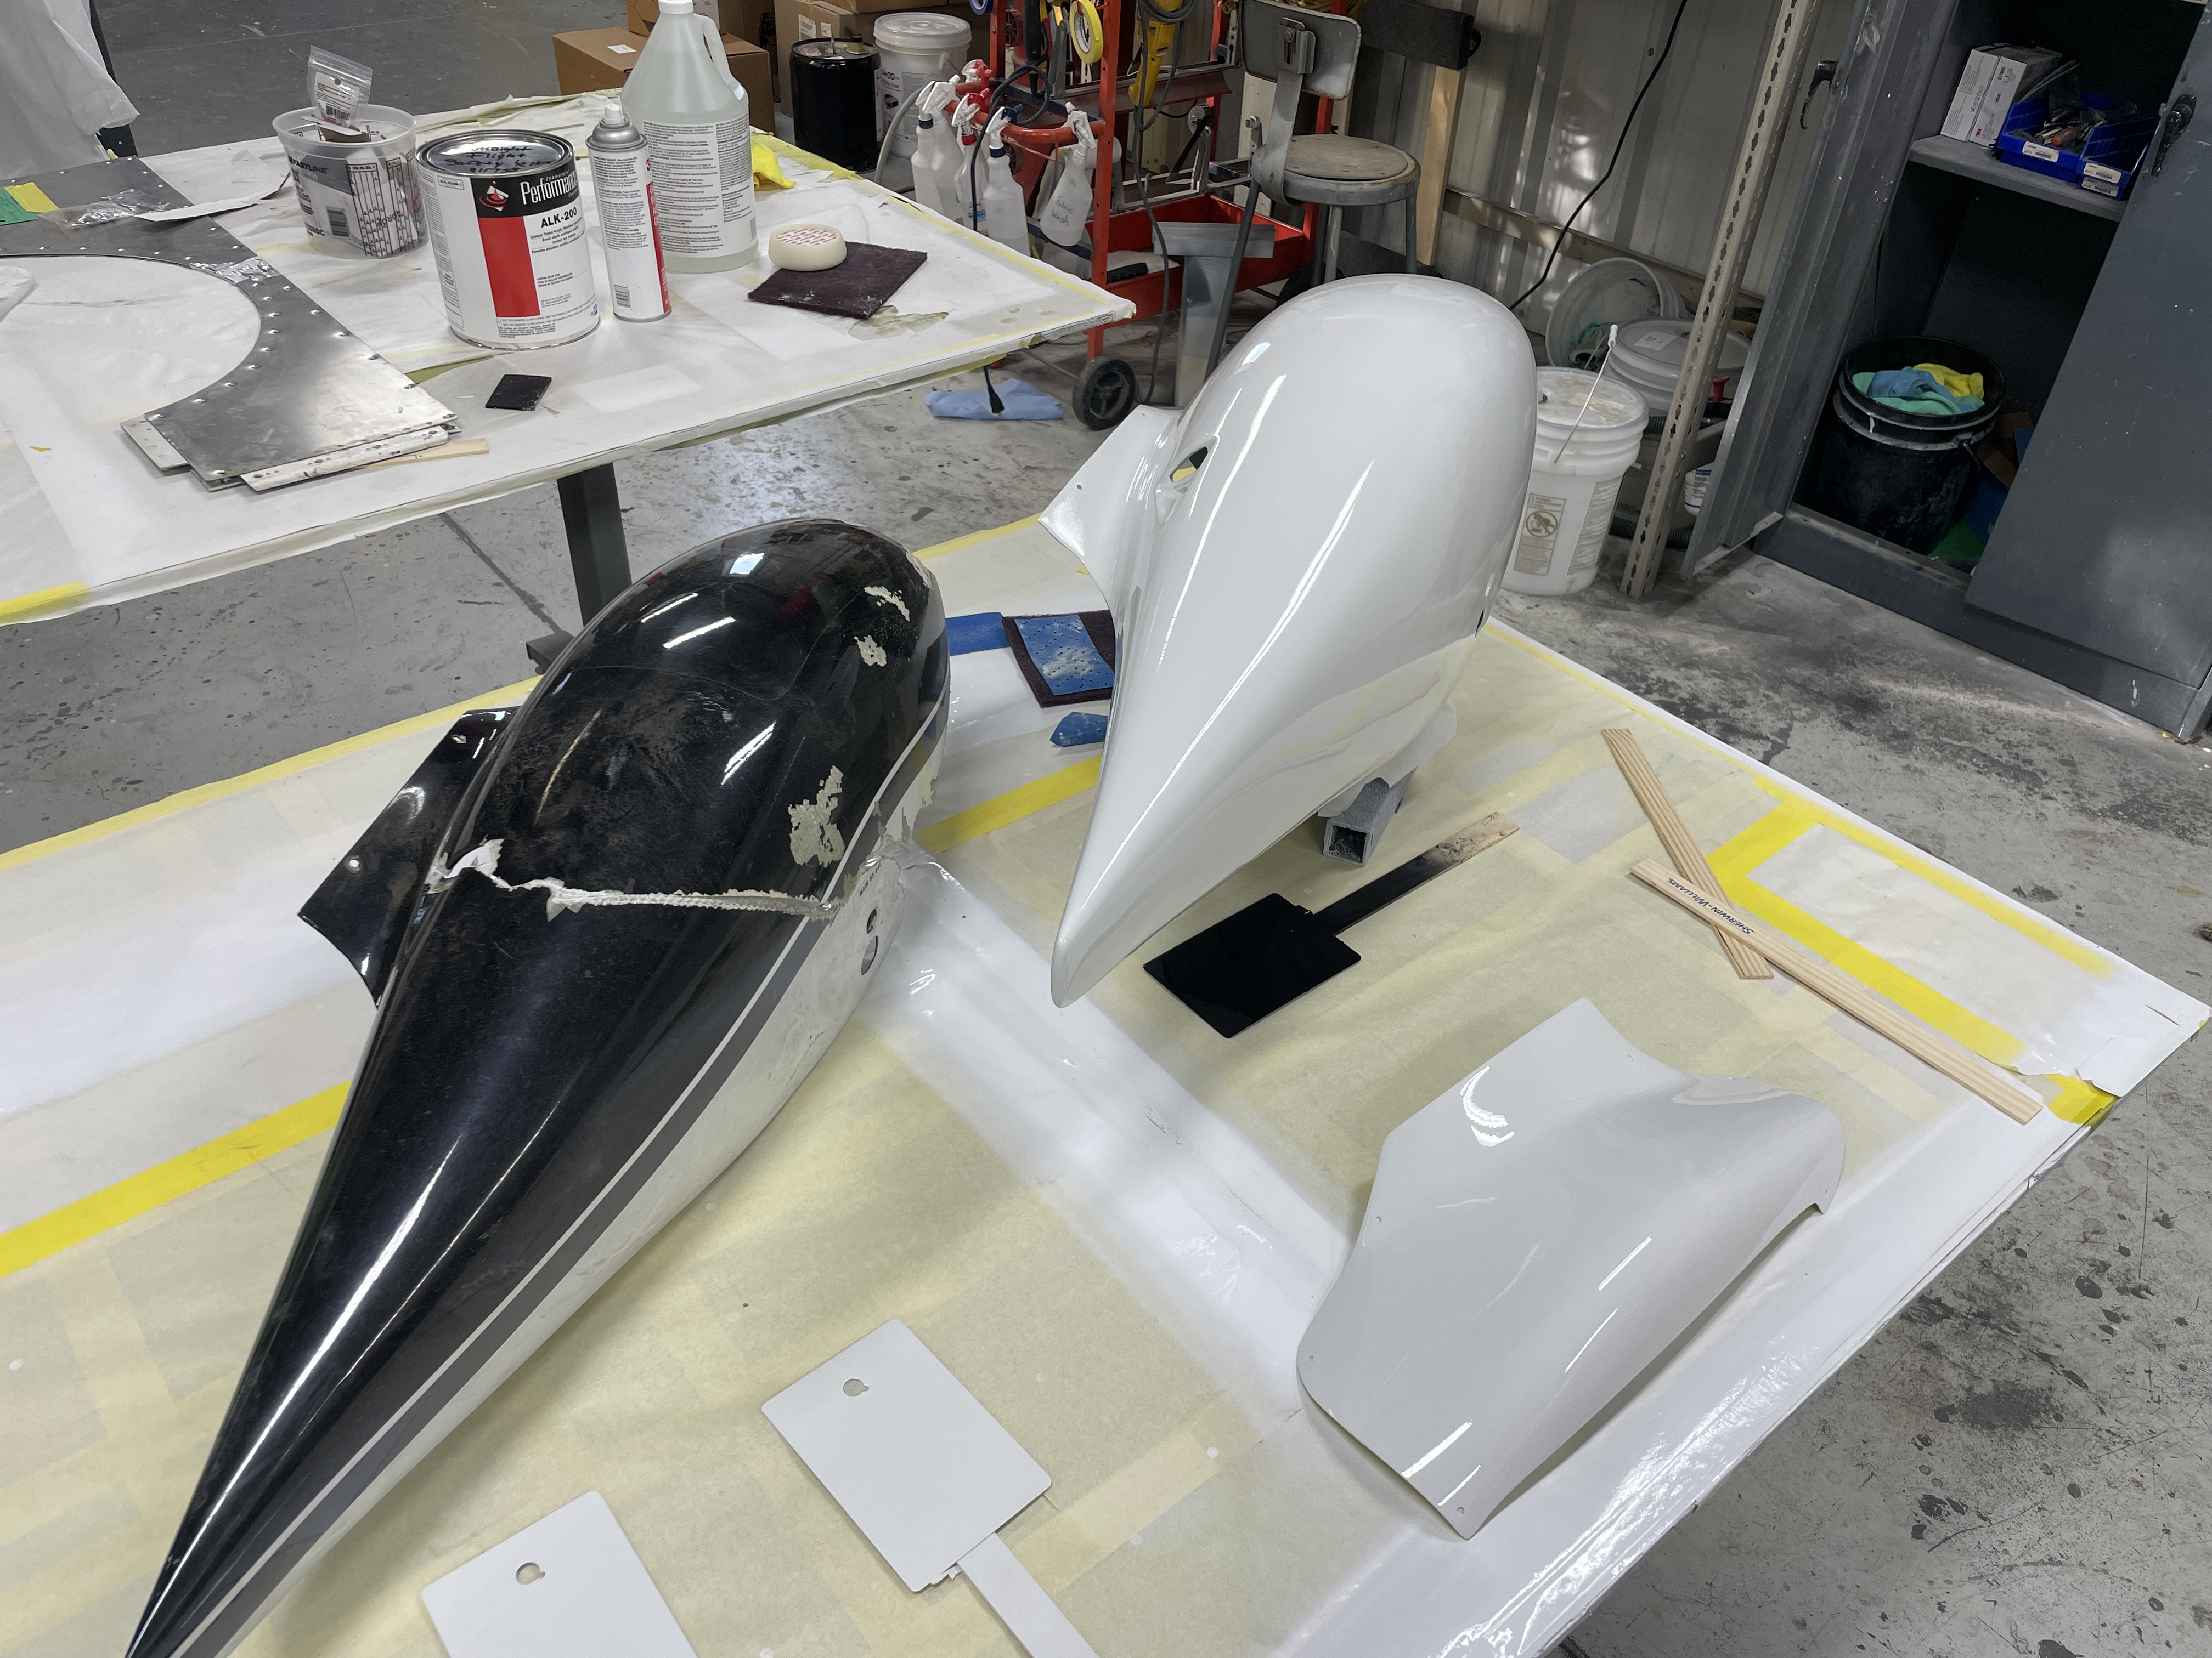
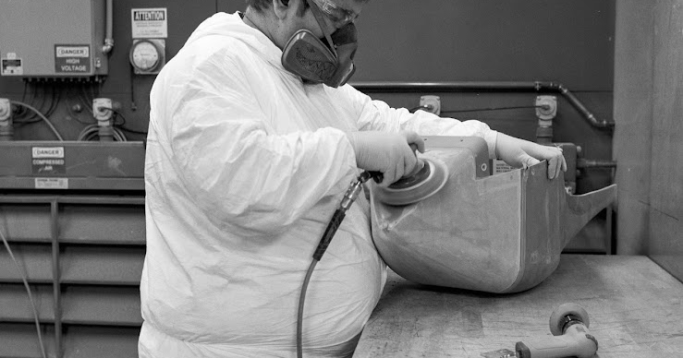
COMPOSITE CAPABILITY STATEMENT
FABRICATION
Composite repair &
manufacturing.
Straight Flight combines our on-staff engineering, composite technicians, NDT Technicians, and paint with local composite DERs and our relationships with OEMs. The result is one coordinated source for structural repair, prototype fabrication and repeat production.
LARGE-COMPONENT PROCESSING
PAINT + FINISH
ON-STAFF ENGINEERING
OUT OF SRM DAMAGE
Design, CAD, substantiation and process support
Composite DERs plus aircraft OEM coordination
FULL REPAIR EXECUTION
PAINT BEFORE RETURN
NDT, layup, core repair, cure control and validation
Install-ready components that reduce AOG handoffs
303-799-8906 | info@straightflight.com | straightflight.com
CONTROLLED SURFACE PREPARATION

Slide 2
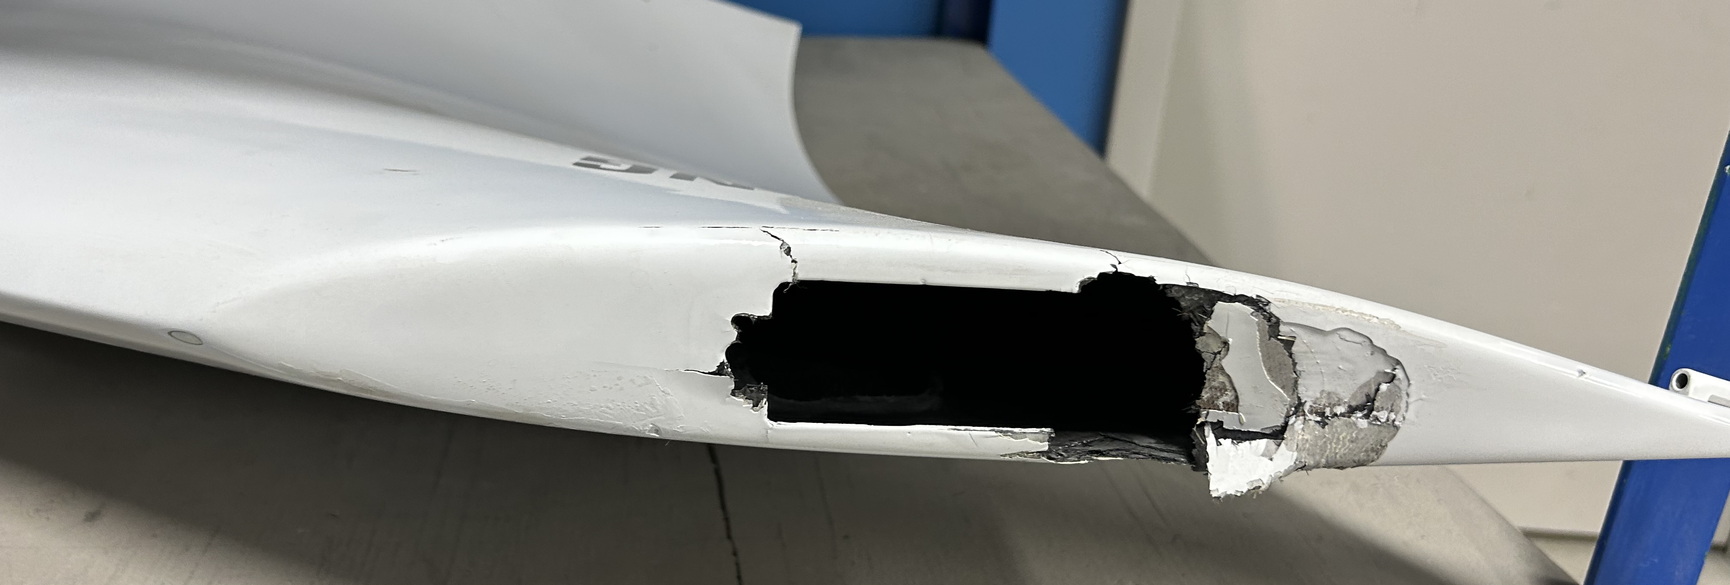
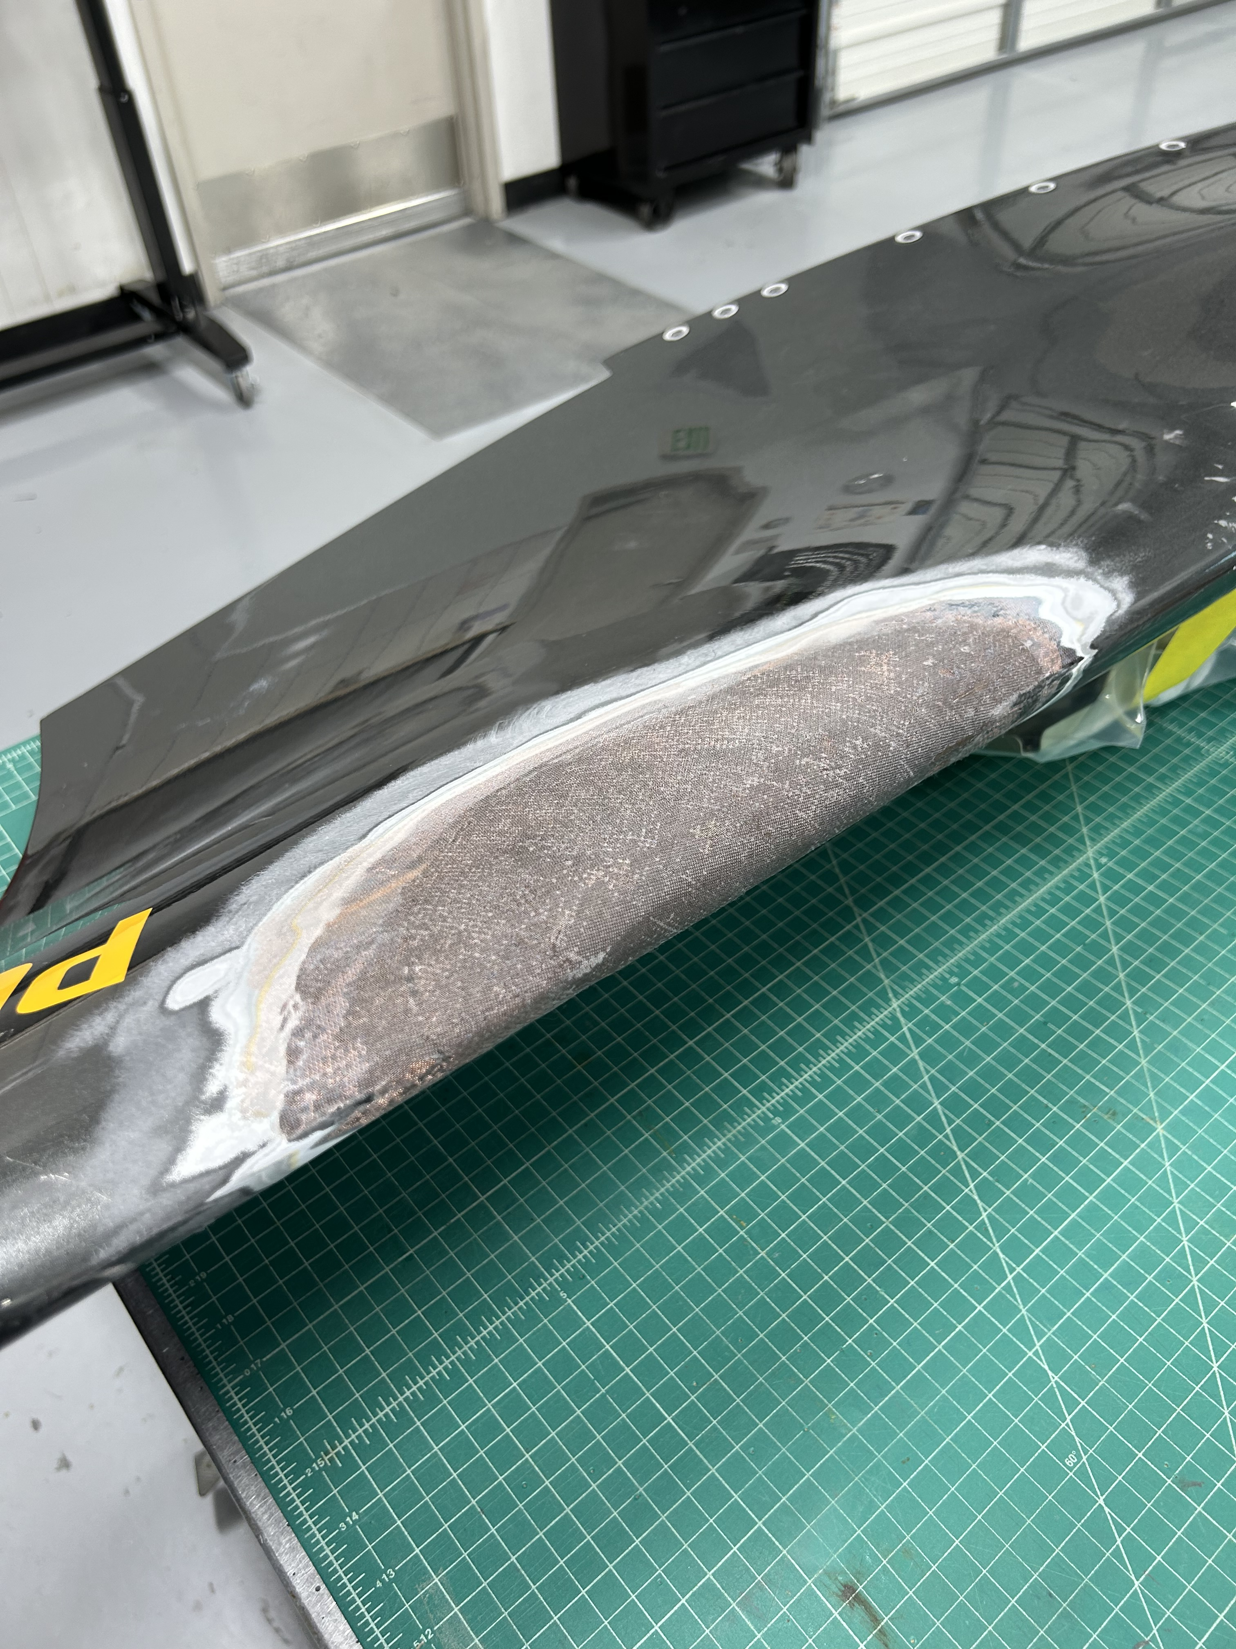
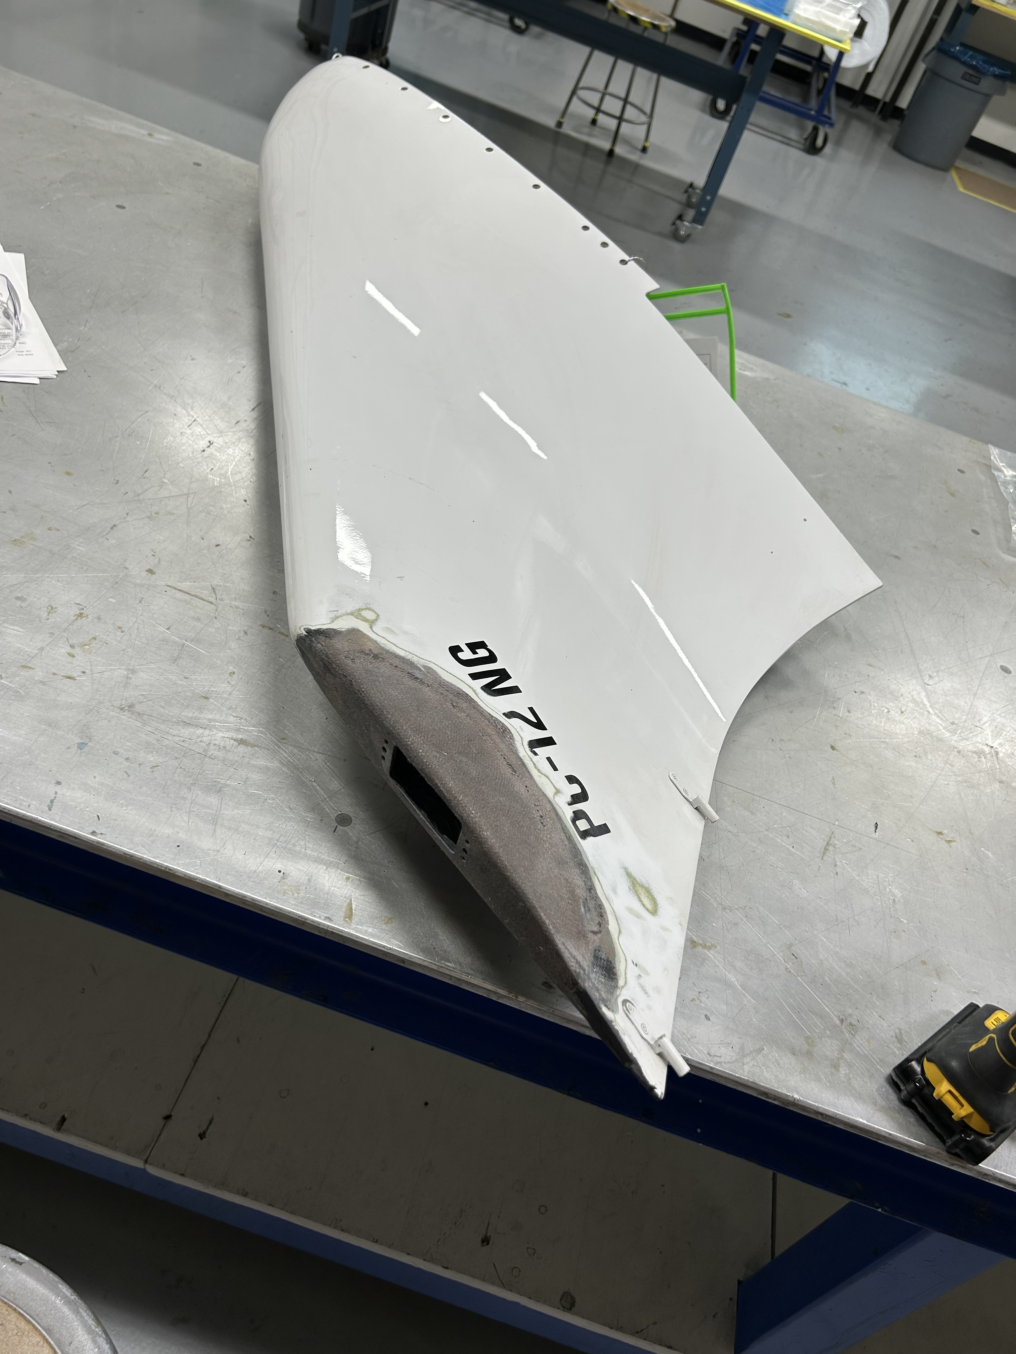
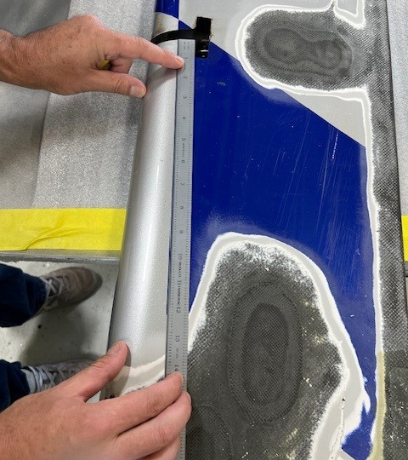
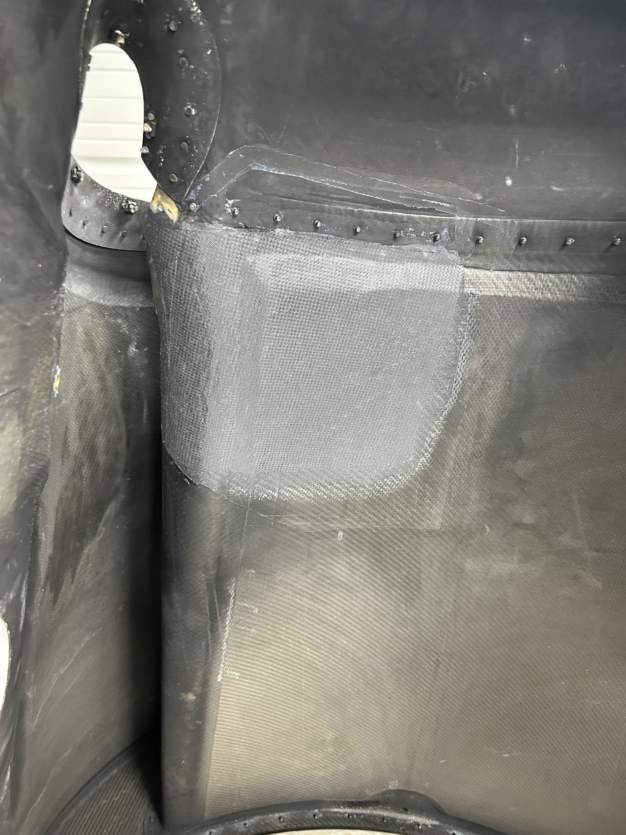
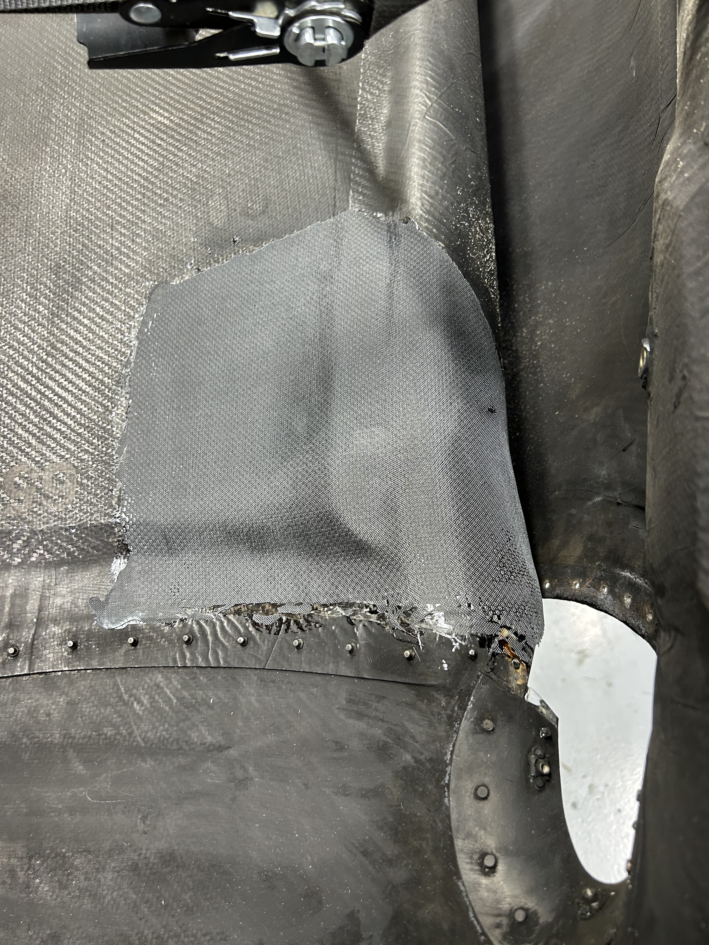
Composite repair: assessment through release.
Straight Flight develops and executes structural and cosmetic repairs in the shop or on the aircraft—with an approval path for damage beyond standard SRM limits.
Damage assessment
Repair data + approval
Impact, delamination, core crush, disbond and thermal damage are sized. Repair areas are defined using visual inspection plus ultrasonic or tap testing.
Existing approved date is used for many repairs. When the damage is not covered by this data, composite DERs or the aircraft OEM are consulted to develop cost-effective approved data.
01 DAMAGE DEFINITION
Controlled execution
Validation + release
Ply-by-ply removal, contamination control, prepreg/wet layup, vacuum bagging, localized cure, core replacement, potting, closeouts and cure monitoring.
Post-repair NDT, dimensional/surface verification, cure records, material traceability, process records and approved documentation support airworthiness release.
SCARF REPAIR
LOAD PATH
SHOP + FIELD CAPABILITY | Localized and out-of-oven repairs can be performed at Straight Flight or supported on-aircraft when the scope allows.
VERIFY
PATCH
CORE
STRAIGHT FLIGHT | COMPOSITE CAPABILITIES
02

Slide 3
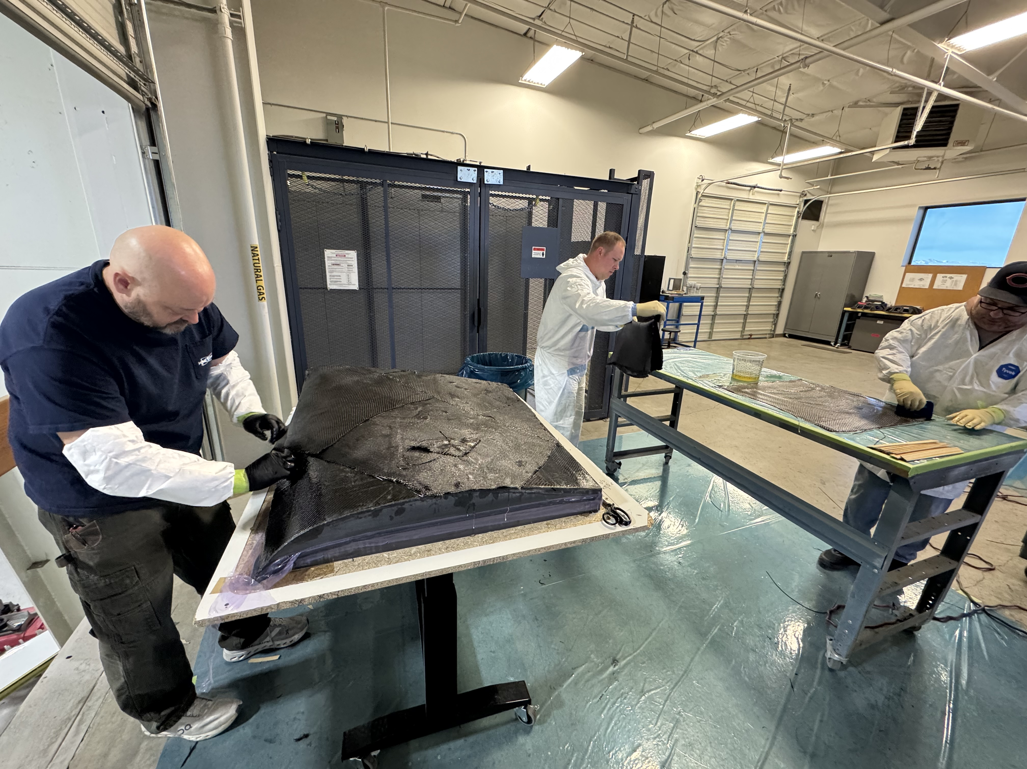
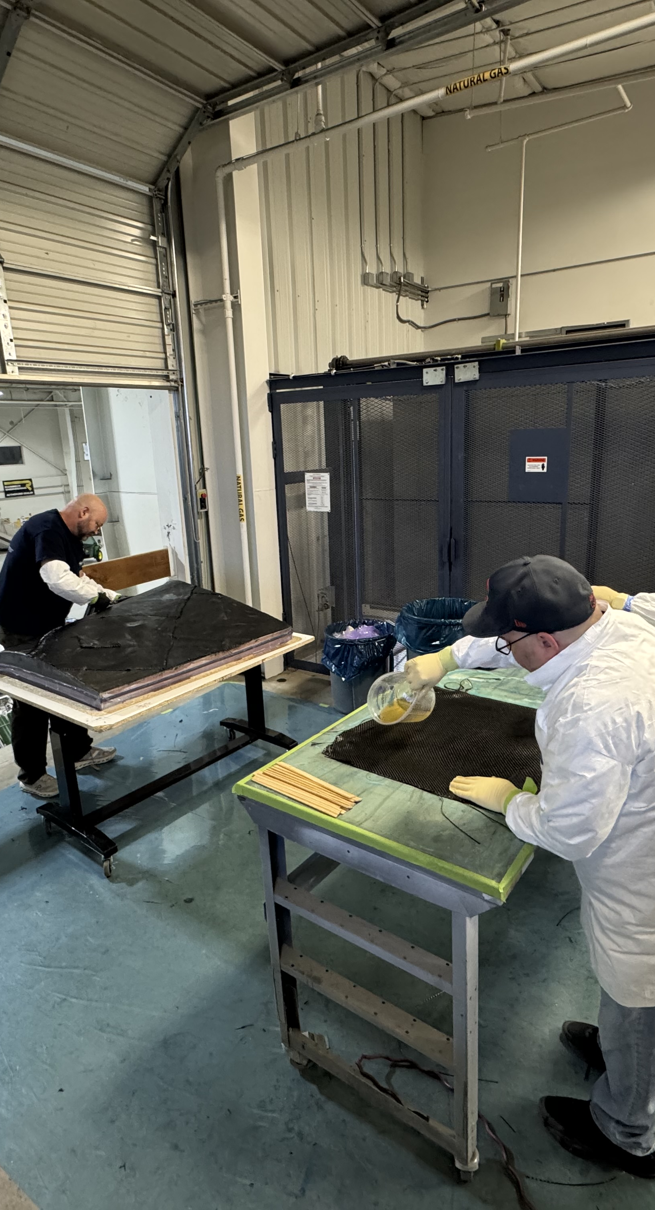
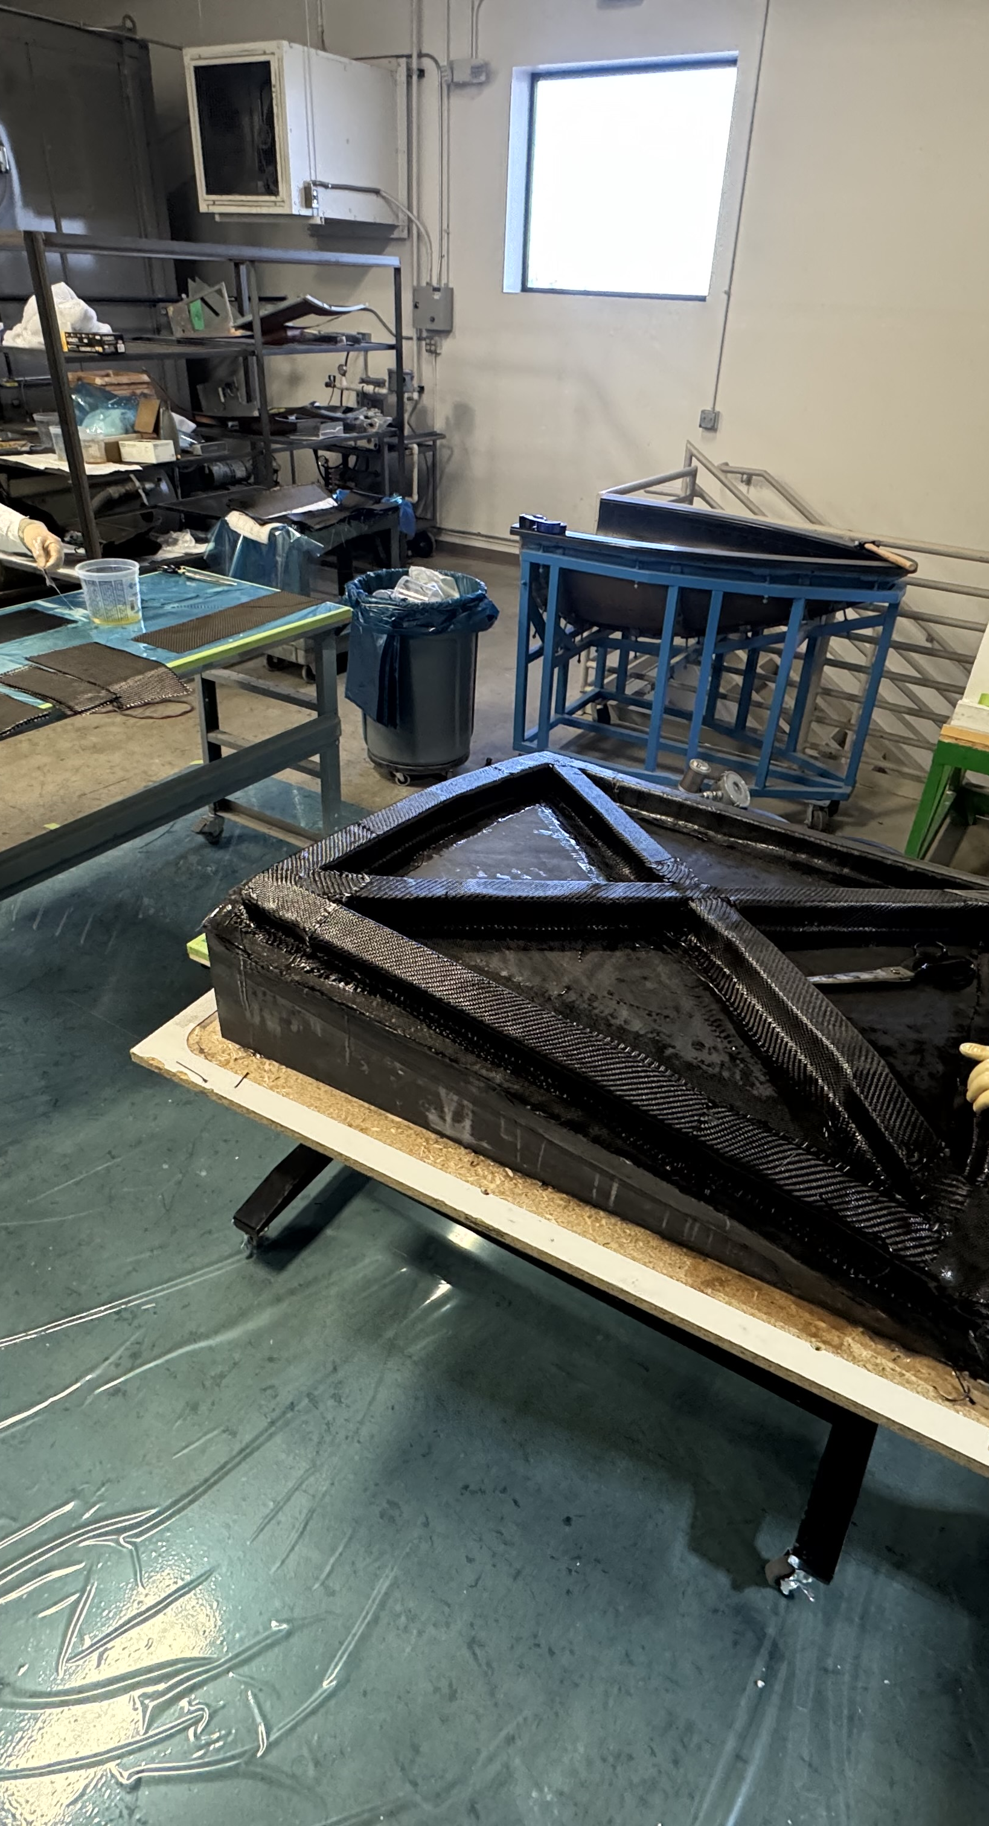
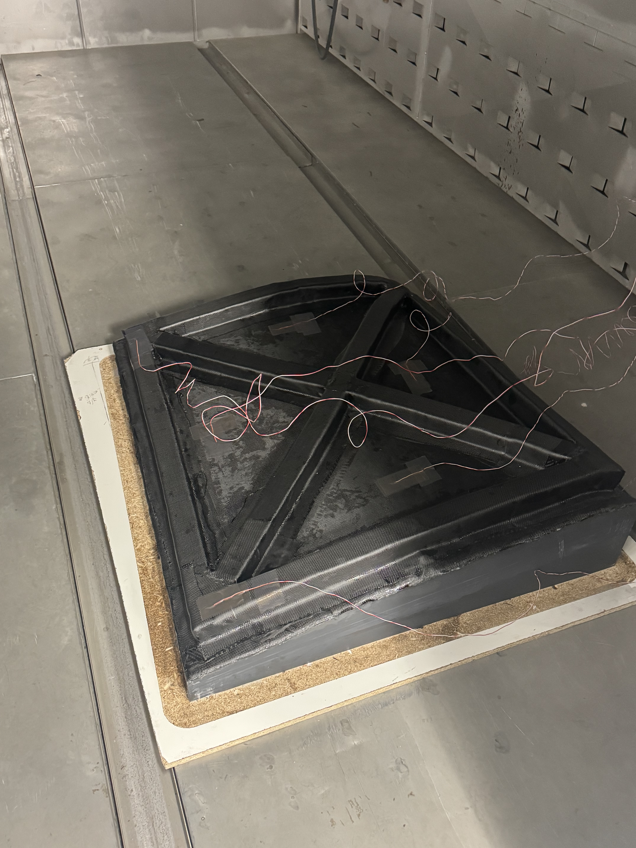
COMPOSITE MANUFACTURING
Design-to-delivery
manufacturing.
Engineering, tooling, processing, inspection and finish are developed together for prototype, low-rate and higher-volume programs.
Engineering + design
Fabrication + processing
• Materials selection + allowables
• CAD, part/tooling design + DFx
• Process development + qualification
• Customer/OEM feasibility support
• Prepreg and wet layup
• Vacuum bagging + localized/OOA cure
• RTM and resin infusion
• Honeycomb/foam core, sandwich panels + bonding
LARGE-SCALE LAYUP
Tooling + production
Post-process + finish
• Molds, fixtures + layup aids
• Release and cured-surface verification
• NDE fixture integration
• Prototype through repeat-production cells
• Precision trim, drill + finishing
• NDT, environmental/process validation
• Paint, coatings + protective finishes
• Assembly, kitting, packaging + delivery
COMPONENT SCOPE | Wings • fuselage sections • panels • fairings • floorboards • subsystems
LAYUP
TOOLING
CURE CONTROL

Slide 4
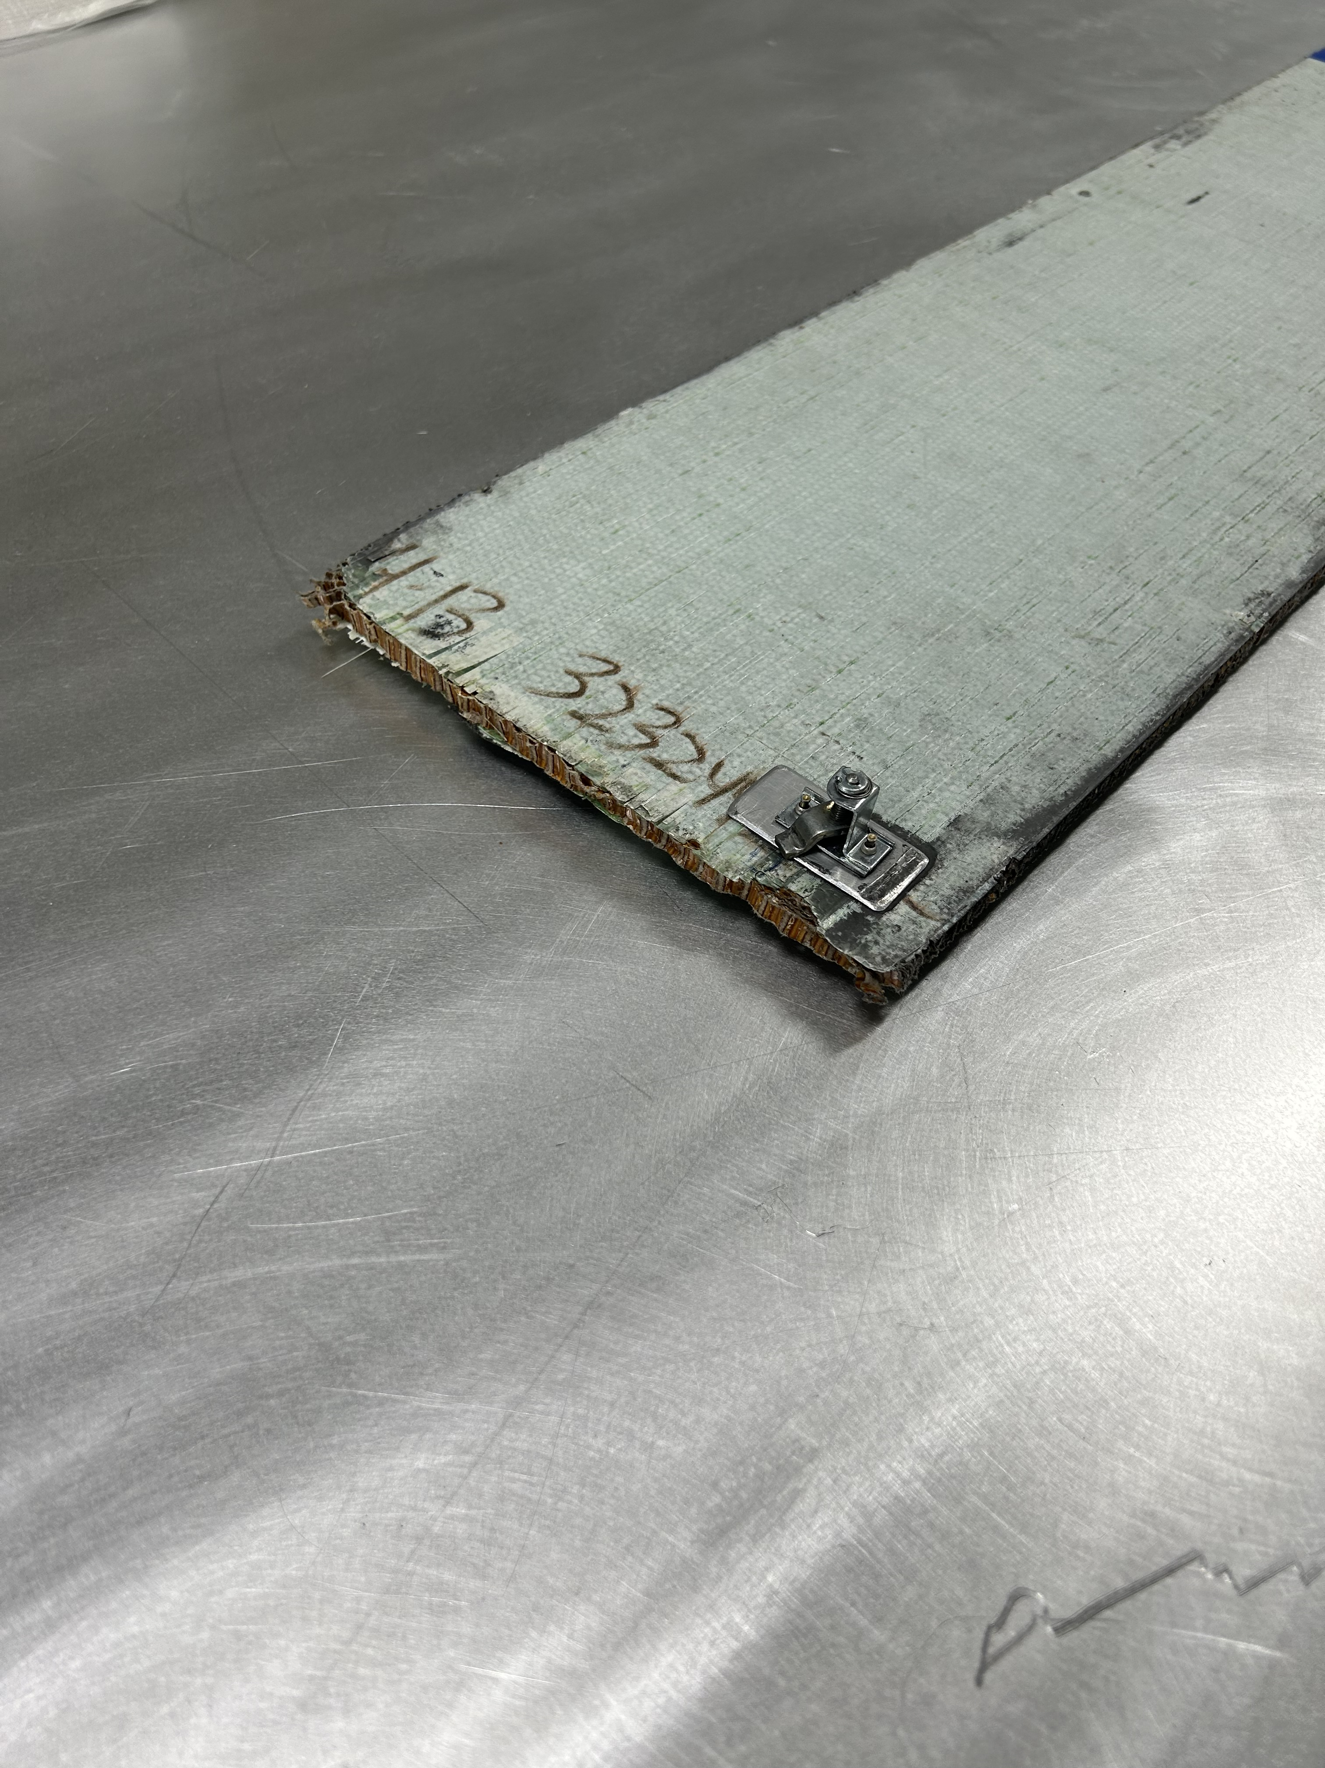
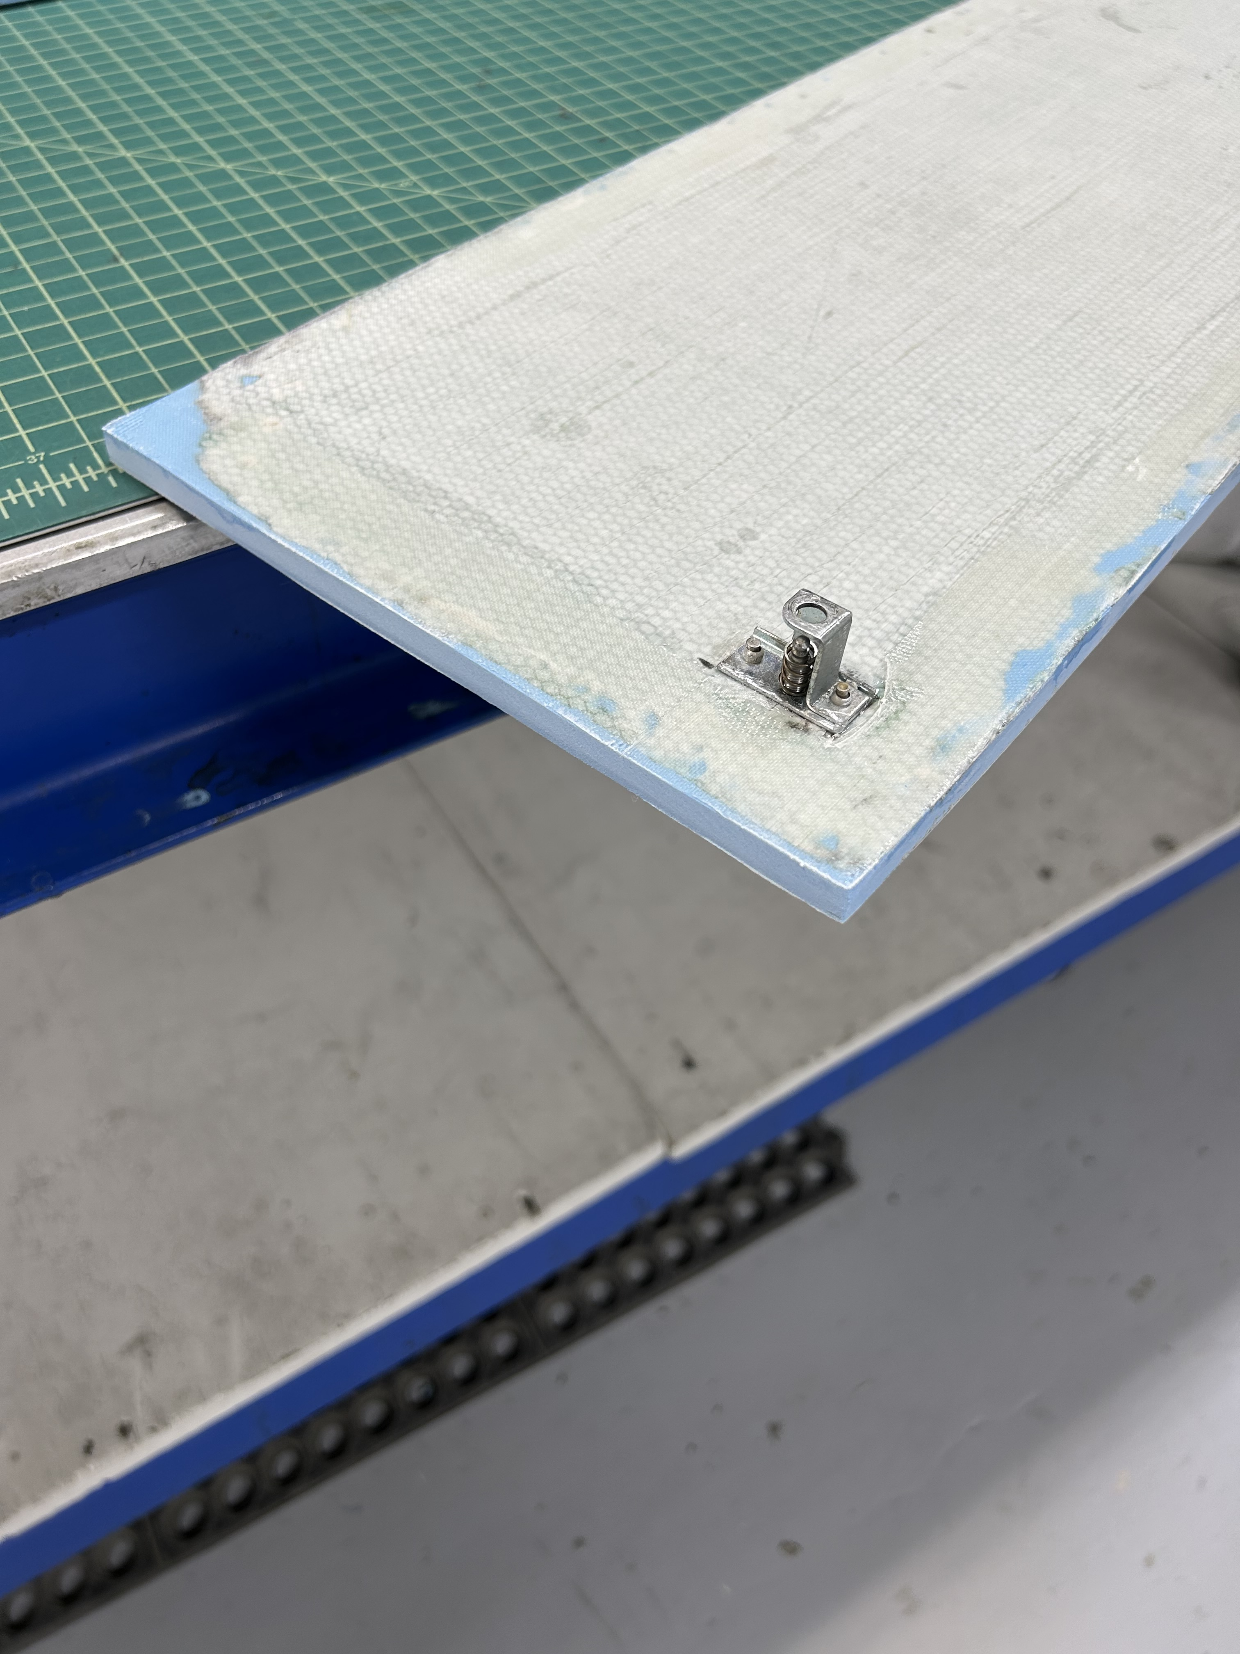
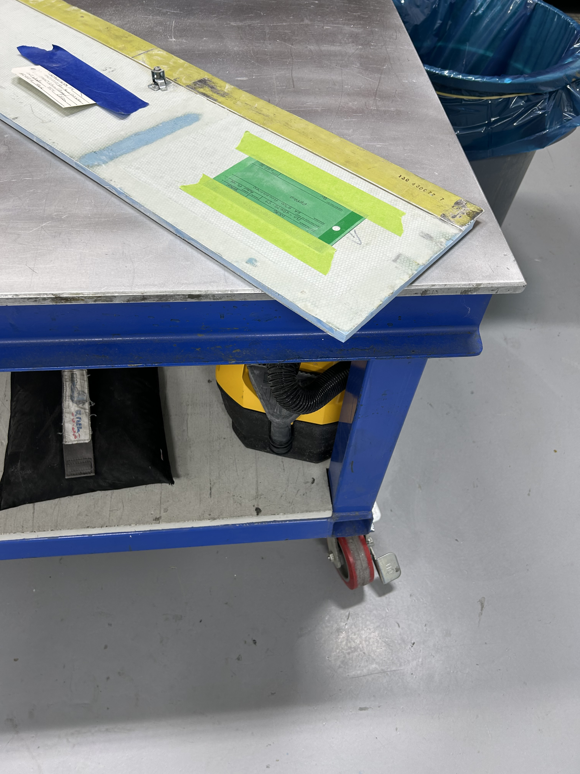
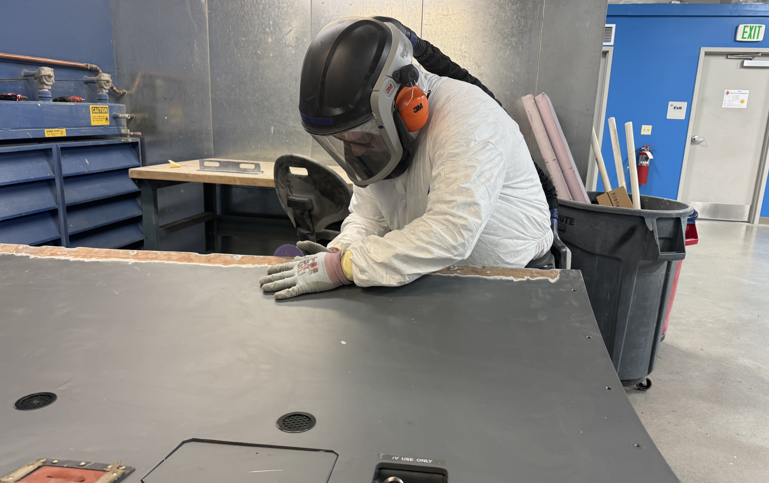
One coordinated shop reduces AOG handoffs.
Engineering, repair, inspection, documentation and paint share the same delivery plan, so the component can return ready for installation.
01 DAMAGE
02 STRUCTURAL REPAIR
03 DOCUMENTED FINISH
SURFACE PREP + PAINT
Accurate Cost and Schedule
Paint before return
Components are inspected upon receipt to determine a complete repair cost and schedule. There are communicated to the customer for their approval.
Paint, coatings and protective finishes are completed before shipment—avoiding a refinishing stop and returning an install-ready component.
SEND THE COMPONENT ONCE.
Straight Flight, LLC
13251 E Control Tower Rd.
Englewood, CO 80112
303-799-8906 | 877-300-9164
info@straightflight.com
straightflight.com
Materials
Certification
Standard repair materials are maintained in stock to support rapid repair of components.
Components are tested and inspected to ensure they meet their return to service requirements before an 8130-3 or EASA Form 1 is issued for the component.
STRAIGHT FLIGHT | COMPOSITE CAPABILITIES
04

